Slide 1
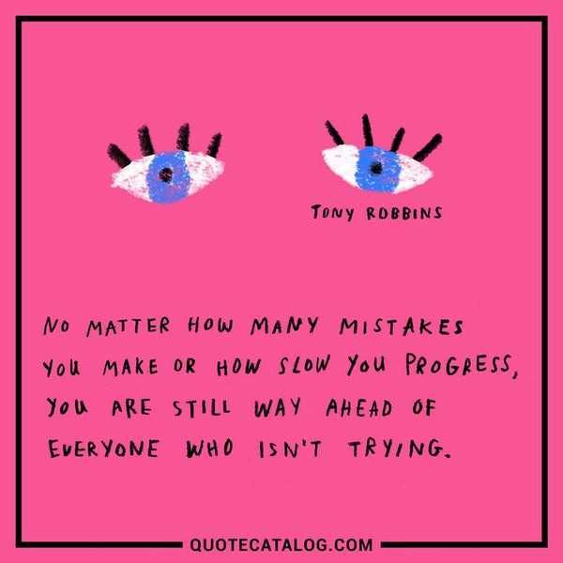
Date: | Human Biology Year 12 ATAR
Do Now Get out your equipment and textbook. Lesson Agenda 1: Do Now 2: Review of Meiosis and Sources of Genetic Variation 3: Start on the Review Worksheet 4: Lesson summary and wind-up Suggested Study Complete review worksheet, then mark and correct using the answer key on Connect. NEXT LESSON Past Exam Question Mutations and Gene Pools | Learning Aims Review understandings of Meiosis and Sources of Variation including: Definition of variation Genetic sources of variation Meiotic Division Crossing Over Random Assortment of Chromosomes during Meiosis Non-Disjunction During Meiosis Random Fertilisation Mutation
 | Key Vocabulary Prophase Metaphase Anaphase Gamete

Slide 2

Meiosis and Sources of Genetic Variation
Revision Prior to Ch 9 HP

Slide 3
What is Variation?
Differences between organisms within a species.
Human Variation:
Height, skin colour, eye colour, weight
Combination of genetics and environment
Learning Aim: Define variation

Slide 4
Genetic Sources of Variation
Random Assortment of Chromosomes during Meiosis
Crossing Over and Recombination during Meiosis
Non-Disjunction during Meiosis
Random Fertilisation
Mutations
Learning Aim: List genetic sources of variation

Slide 5
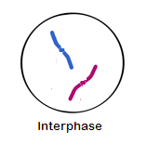
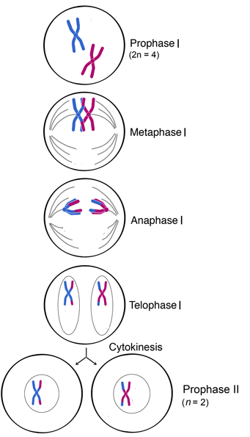
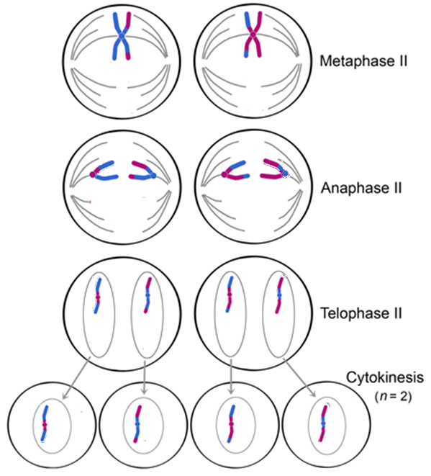
Meiosis: Showing what happens with a single homologous pair of chromosomes.
Remember: this is happening with each of the 23 pairs in each cell that divides.
Crossing Over!
First Meiotic Division:
Homologous pairs engage in “crossing over”: they exchange a little of each other’s DNA.
Homologous pairs separate, so one of each pair moves to each pole
At beginning of Prophase II, a haploid karyotype of single chromosomes is present
Second Meiotic Division:
Chromosomes line up on spindle
Pulled apart during anaphase
End result is 4 cells, each with a unique haploid karyotype of unduplicated chromatids.
Learning Aim: Describe the main events in the first and second meiotic division

Slide 6
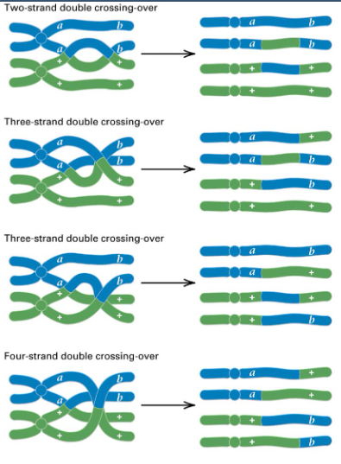
Crossing Over during Meiosis
Occurs during Meiosis I.
Homologous pairs exchange some alleles.
This results in far more gamete combinations than if crossing over didn’t occur.
Note: Crossing Over can happen in multiple ways. It is possible to produce a recombinant chromatid in each gamete for a given chromosome.
Without crossing over, there would only have been two possible gametes for these alleles.
Crossing over occurs at multiple loci (places) in each chromosome pair. That is a lot of variation across a single karyotype!
Learning Aim: Describe the process of Crossing Over during Meiosis I

Slide 7
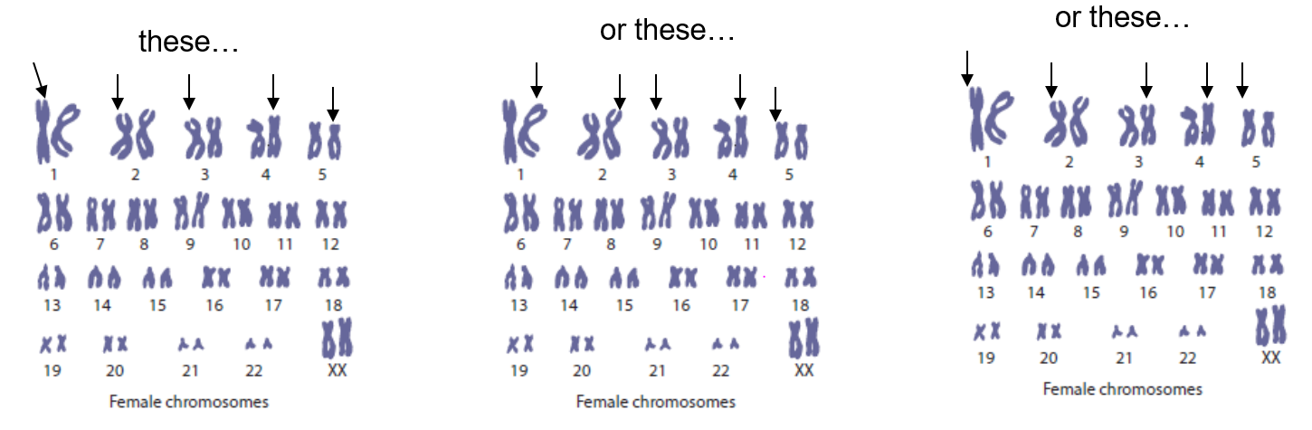
Random Assortment of Chromosomes during Meiosis
Happens during Meiosis I:
Homologous pairs separate: one ends up in each cell at the end of Meiosis I.
Karyotype contains 23 chromosome pairs.
Lots of possible different combinations depending on which of each pair ends up in a cell, eg:
or these…
or these…
these…
So, in total, each cell could produce any two of 2²³ possible random assortments of chromosomes (That is approx 8.5 million combinations)
AND each karyotype is unique also, AND the other gamete that fuses during fertilisation is ALSO one of 8.5 million combinations! That is a LOT of possible offspring karyotypes!
Learning Aim: Describe random assortment of chromosomes during Meiosis

Slide 8
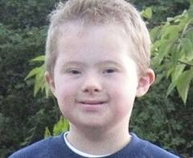
Non-Disjunction During Meiosis
Where some chromosome pairs do not separate properly during meiosis.
Can occur during Meiosis I or Meiosis II.
Results in a Karyotype with an abnormal chromosome number, after fertilisation.
Generally results in severe birth defects, or miscarriage.
Generally not an advantageous source of genetic variation.
Examples include:
Down Syndrome
Turner’s Syndrome
Klinefelter’s Syndrome
Cri-du-chat Syndrome
Learning Aim: Describe the effects of non-disjunction during Meiosis

Slide 9
Random Fertilisation
Refers to the fact that an egg can be fertilised by any one of many different sperm.
Means more variation in offspring.
Mutations
Random permanent changes in DNA.
Variety of causes
Learning Aim: Briefly describe random fertilisation and mutation

Slide 10
New Variations and Survival
Some variations can be an advantage because:
Some of the population is likely to survive during adversity eg:
People who store fat easily more likely to survive famine
People who have extra body hair more likely to survive an ice age
People heterozygous for sickle cell anaemia don’t get malaria as badly.

